Slide 1
CIS532: Estimating Probability Distributions
Live Session 2
Ernest Green
Notes:
Note: This presentation is based substantially on work done by Melynda Eden, eCornell Machine Learning Facilitator, for version 1 of this course.

Slide 2
Today’s Live Session
Reminder: Loops vs. Vectorization and NumPy
Build a Baby Name Classification System

Slide 3
Additional Resources
Lecture 7 "Estimating Probabilities from Data: Maximum Likelihood Estimation" -Cornell CS4780 SP17
https://www.youtube.com/watch?v=RIawrYLVdIw
Machine Learning Lecture 8 "Estimating Probabilities from Data: Naive Bayes" -Cornell CS4780 SP17
https://www.youtube.com/watch?v=pDHEX2usCS0
Machine Learning Lecture 9 "Naive Bayes continued" -Cornell CS4780 SP17
https://www.youtube.com/watch?v=VDK0nkjFh5U
Machine Learning Lecture 10 "Naive Bayes continued" -Cornell CS4780 SP17
https://www.youtube.com/watch?v=rqB0XWoMreU
Machine Learning Lecture 11 "Logistic Regression" -Cornell CS4780 SP17
https://www.youtube.com/watch?v=GnkDzIOxfzI

Slide 4
Recommended Reading
The Likelihood of Tails vs. “Not Heads”
https://jasondeden.medium.com/heads-or-tails-or-23803e913c1
Log Math Basics
https://jasondeden.medium.com/taking-the-log-of-my-own-i-d0981be4ce51
Indexing and Slicing
https://jasondeden.medium.com/array-indexing-slicing-vs-loops-753484854bc8

Slide 5
NumPy and Vectorization vs. Loops
Python is an interpreted language, not compiled
Loop iterations are processed sequentially
NumPy has built-in array functions that first compile the instructions and run them in a lower-level language
A small performance hit for the first iteration due to compile time, but afterwards operations can be implemented in parallel
But what if you need to perform the same evaluation or operation across a large number of array values and no built-in NumPy function exists?

Slide 6
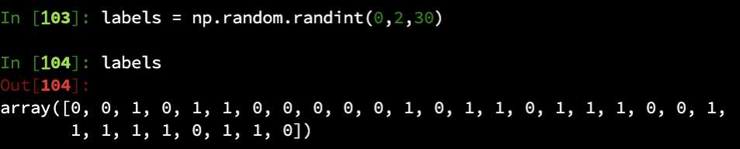
Problem - we want to recode all 0’s as -1’s
We could write a loop to iterate over the array and check if the number == 0 and set the value to -1

Slide 7
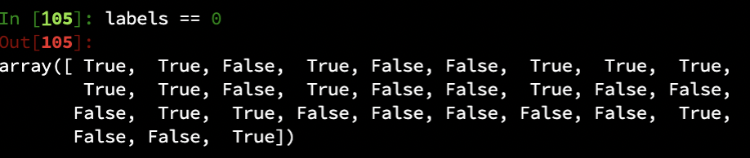
Problem - we want to recode all 0’s as -1’s
We could write a loop to iterate over the array and check if the number == 0 and set the value to 1
Or we can start by creating an index based on a simple evaluation (>, <, ==, etc.)

Slide 8
This is an index of all values that meet the criteria specified

Slide 9
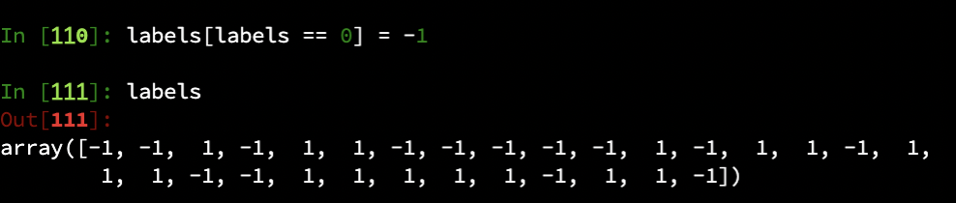
This is an index of all values that meet the criteria specified
...which can be used to perform replacement operations in parallel

Slide 10
This is an index of all values that meet the criteria specified
...which can be used to perform replacement operations in parallel
…the key value being it took one iteration, one line of code, vs. 30 repeated iterations for the loop approach, to get to the same result

Slide 11
How Much Faster Is It Really?
https://jasondeden.medium.com/eat-my-dust-loops-33e5279a01de
Summary:
Operation on an array that takes > 20 seconds using loops and around 17 seconds using a list comprehension takes under 600 milliseconds using vectorization and around 300 milliseconds using NumPy
Performance gain of up to 70x for using optimal approach

Slide 12
Classification Problem
In the Class Prior exercise, we were given 1’s and 0’s and asked to determine class priors, which could simply be calculated as np.mean(array). But what if our labels were 1 and -1? Or boy and girl?
In Python, True == 1 and False == 0. Can you use this to create code that works for any binomial distribution and computes class priors?

Slide 13
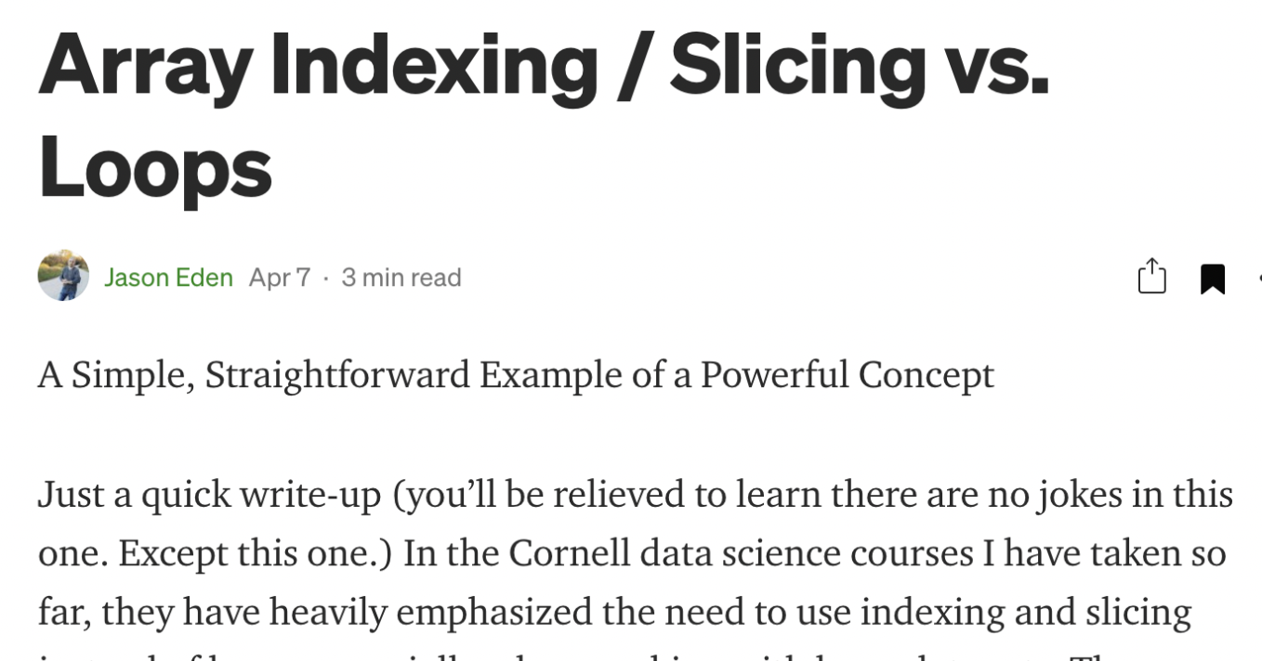
Use one array to index another one...
https://jasondeden.medium.com/array-indexing-slicing-vs-loops-753484854bc8

Slide 14
Build a Baby Name Classification System
Functions Given:
hashfeatures
name2features
genTrainFeatures
Functions to write (graded):
naivebayesPY
naivebayesPXY
loglikelihood
naivebayes_pred

Slide 15
Challenge Exercise - Creating Structure
Take the logic from the exercise and create a feature vector of the same length for every word in your data and indicates 1 for the position of every vowel.
Then create another feature vector that indicates 1 for the position of every consonant.
Question: How long do these feature vectors need to be?
Question 2: If you combined them, could you determine the length of any given word given only the string of 1’s and 0’s you generated?

Slide 16
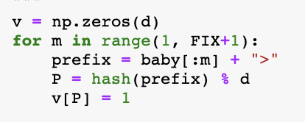
hashfeatures

Slide 17
hashfeatures
Assume we don’t understand everything this function is doing. How can we gain that understanding?

Slide 18
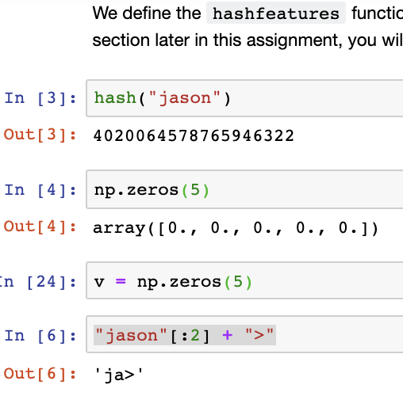
hashfeatures

Slide 19
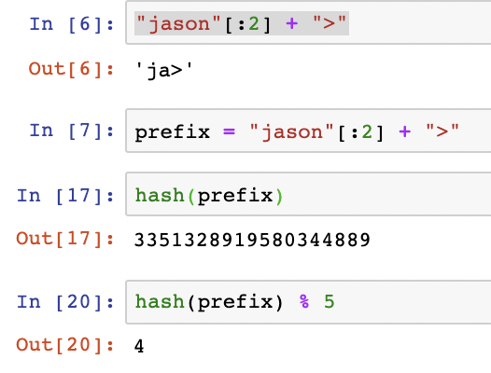
hashfeatures

Slide 20
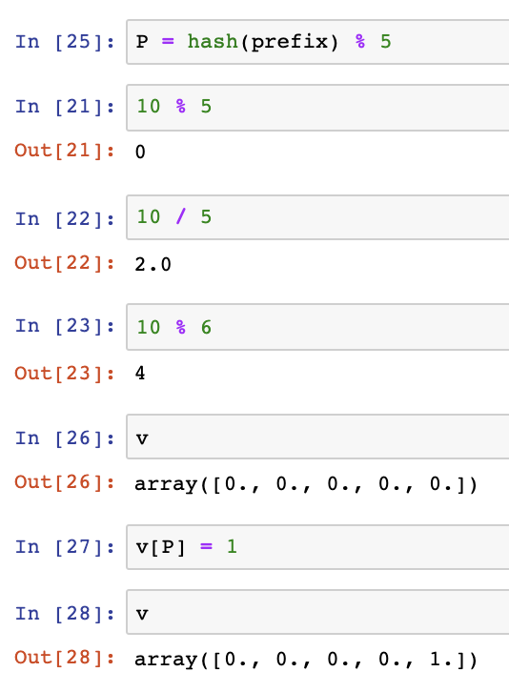
hashfeatures

Slide 21
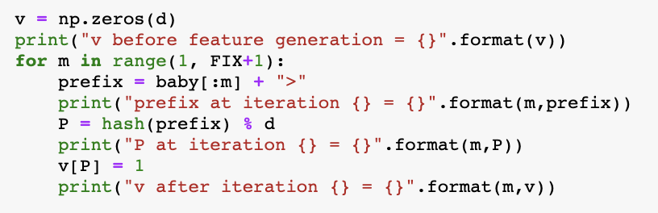
hashfeatures
Notes:
Show expanding functions using print statements for deeper examination

Slide 22
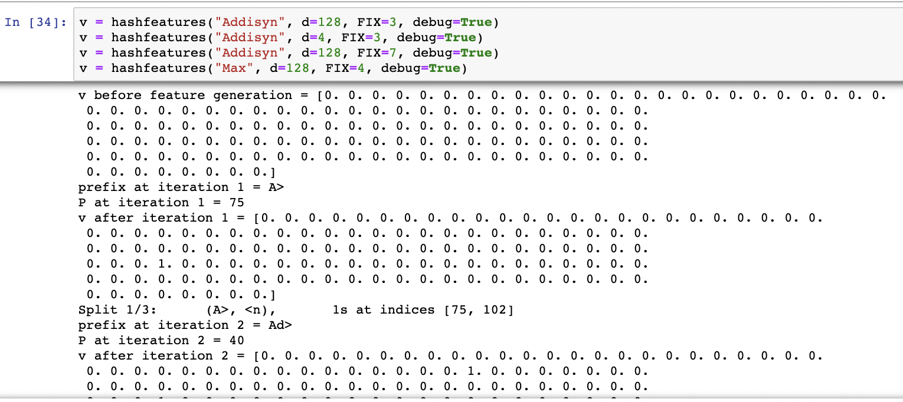
hashfeatures

Slide 23
hashfeatures

Slide 24
hashfeatures

Slide 25
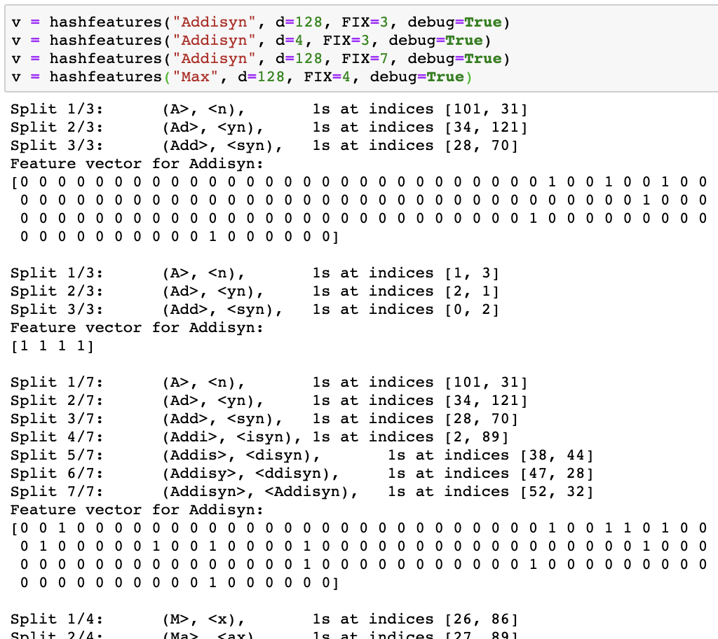
hashfeatures
debug = True provides useful data

Slide 26
hashfeatures Psuedocode
Initialize an array (v) of d zeros
Generate a prefix feature (m sequence of characters)
Hash to make this numeric
Take modulus d of hash to generate a remainder / index value
Set index at that location = 1
Generate a suffix feature (m sequence of characters)
(Repeat steps for prefix)
Iterate/repeat, m += 1 (or m = m+1) until reach FIX+1
If debug = True, print some info

Slide 27
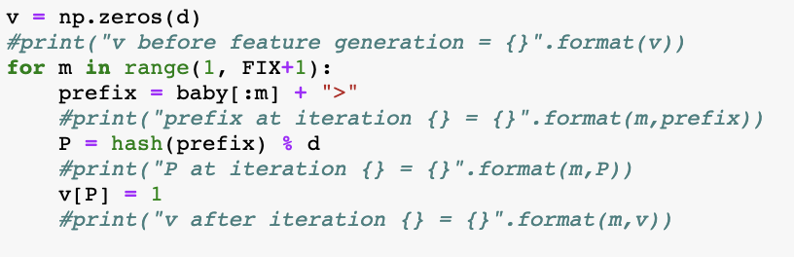
Don’t Forget to Clean Up

Slide 28
name2features
Load a file of names
Use hashfeatures to generate a vector for each one
How might you find out how many boy and girl names you have in your data?
Why might this matter later?

Slide 29
genTrainFeatures
Load girl names and run through name2features
Load boy names and run through name2features
Concatenate the two outputs
Generate labels (girls = -1, boys = 1)
Shuffle data such that labels still match original vectors
Next: Hand this data to the data scientist for evaluation! :)

Slide 30
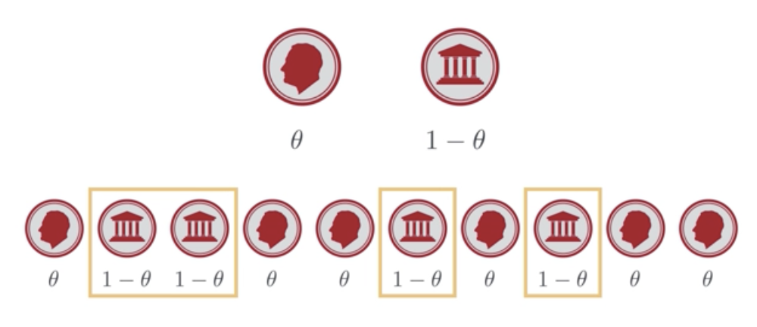
naivebayesPY
Hint: Forget that you know anything about the data. If this were a series of coin flips, what do we assume the overall probability to be based only on label distribution?
P(y)
P(girl)
P(boy)

Slide 31
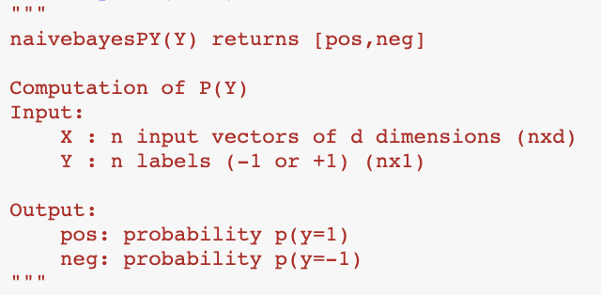
Use Comments as Guides for Function Format

Slide 32
Use Comments as Guides for Function Format

Slide 33
naivebayesPXY
P( x|y)
P(“index 0 = 1” |y)
P(“index 1 = 1” |y)
P(“index 2 = 1” |y)
…
P(“index 54 = 1” |y)
...

Slide 34
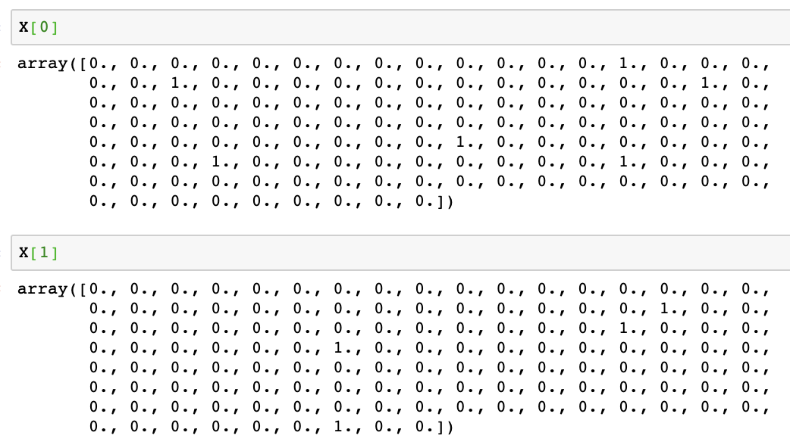
naivebayesPXY
P( x|y)
P(“index 0 = 1” |y)
P(“index 1 = 1” |y)
P(“index 2 = 1” |y)
…
P(“index 54 = 1” |y)
...

Slide 35
Calculate Probability for Each Feature
 | F1 | F2 | F3 | F4 | F5 | F6 | F7 | ... | F128
Boy1 | 0 | 0 | 0 | 0 | 0 | 0 | 1 | ... | 0
Boy2 | 0 | 0 | 1 | 0 | 0 | 1 | 0 | ... | 0
Boy3 | 1 | 0 | 1 | 0 | 0 | 1 | 0 | ... | 1
Boy4 | 0 | 0 | 0 | 0 | 1 | 0 | 0 | ... | 1
Boy5 | 0 | 0 | 1 | 1 | 0 | 0 | 1 | ... | 0
... | ... | ... | ... | ... | ... | ... | ... | ... | ...
Boy54 | 0 | 1 | 0 | 1 | 0 | 0 | 0 | ... | 0
?
?
?
?
?
?
?
?
?

Slide 36
naivebayesPXY
P( x|y)
P(“index 0 = 1” |y)
P(“index 1 = 1” |y)
P(“index 2 = 1” |y)
…
P(“index 54 = 1” |y)
...
How large or small are these probabilities going to be if there are hundreds of names being evaluated?

Slide 37
naivebayesPXY
P( x|y)
P(“index 0 = 1” |y)
P(“index 1 = 1” |y)
P(“index 2 = 1” |y)
…
P(“index 54 = 1” |y)
...
What is this doing?

Slide 38
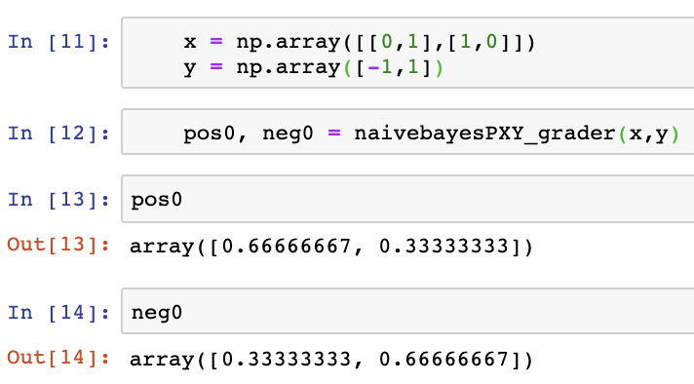
naivebayesPXY
Example shows two observations with d = 2.
If it’s not obvious, recreate a simple example using the grader function
Still not obvious? Generate a slightly more complex example and look at the outputs.

Slide 39
Avoid Loops! (When possible…)
How can you sort out the data (separate boy/girl names/labels) without using loops?

Slide 40
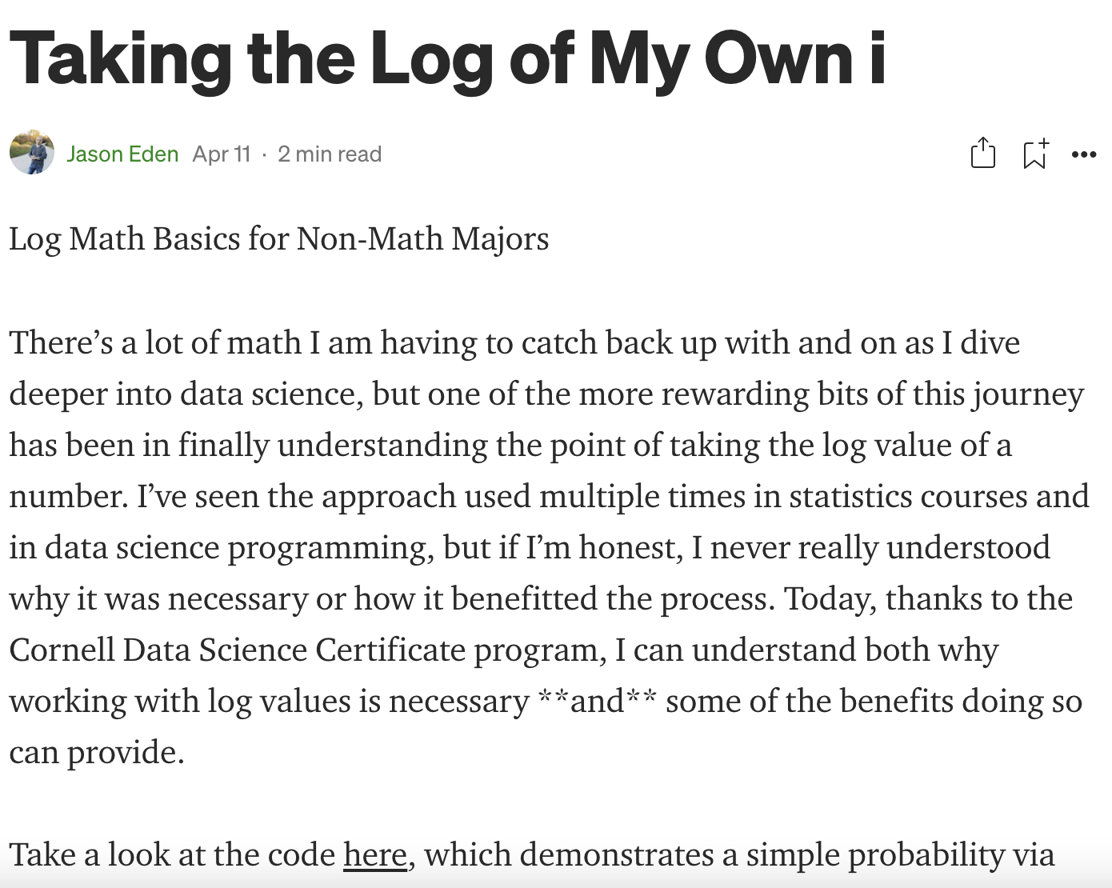
loglikelihood
Why are we using log?
https://jasondeden.medium.com/taking-the-log-of-my-own-i-d0981be4ce51

Slide 41
loglikelihood
Also simplifies chain rule calculation:
log(ab) = log a + log b

Slide 42
loglikelihood
Also simplifies chain rule calculation:
log(ab) = log a + log b
However, you’re only going to return a single vector. How can we code so that we are calculating girls and boys separately, but returning a single vector of likelihoods, without loops?

Slide 43
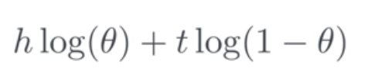
loglikelihood
Also simplifies chain rule calculation:
log(ab) = log a + log b

Slide 44
loglikelihood
Also simplifies chain rule calculation:
log(ab) = log a + log b
theta = [posprob_{i} | negprob_{i}]

Slide 45
loglikelihood
Also simplifies chain rule calculation:
log(ab) = log a + log b
h = [X_{i}[boys] | X_{i}[girls]]
t = ????

Slide 46
loglikelihood
Also simplifies chain rule calculation:
log(ab) = log a + log b
h = [X_{i}[boys] | X_{i}[girls]]
t = ????
How would you represent tails in terms of heads? In other words, if h = x, t in terms of x = ?

Slide 47
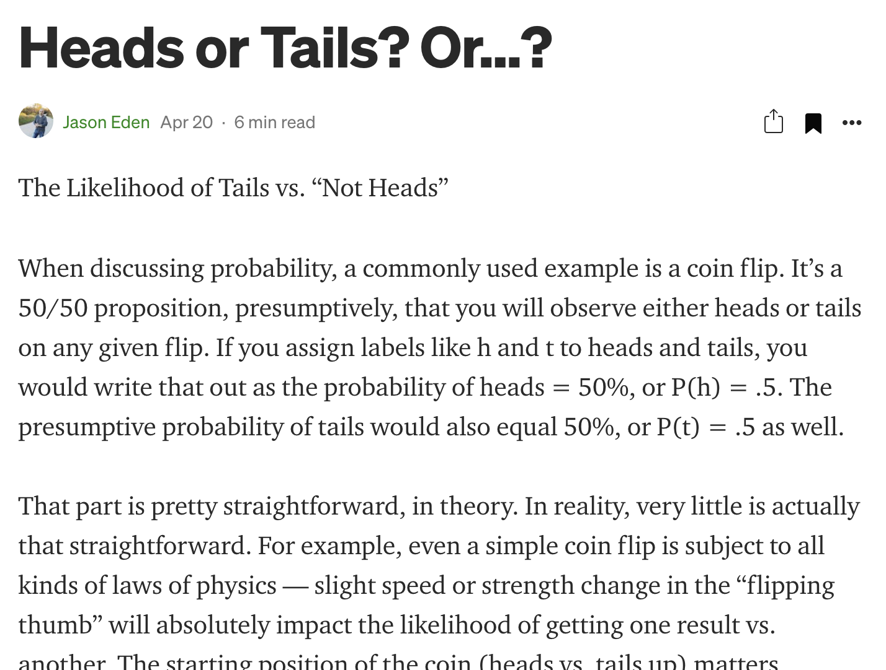
Heads Up!*
posprob ≠ (1 - negprob)
(≠ “does not equal”)
*pun intended
https://jasondeden.medium.com/heads-or-tails-or-23803e913c1

Slide 48
naivebayes_pred
Given novel X (X_test_{i}) calculate likelihood this would be a boy
(Put another way, assume X_test_{i} label = 1. How likely was that?)

Slide 49
naivebayes_pred
Given novel X (X_test_{i}) calculate likelihood this would be a boy
(Put another way, assume X_test_{i} label = 1. How likely was that?)
Repeat, for girl (assume X_test_{i} label = -1)
Which number is bigger? That’s your prediction!

Slide 50
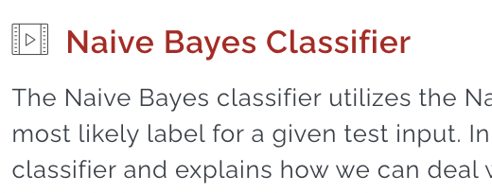
naivebayes_pred
Given novel X (X_test_{i}) calculate likelihood this would be a boy
(Put another way, assume X_test_{i} label = 1. How likely was that?)
Repeat, for girl (assume X_test_{i} label = -1)
Which number is bigger? That’s your prediction!

Slide 51
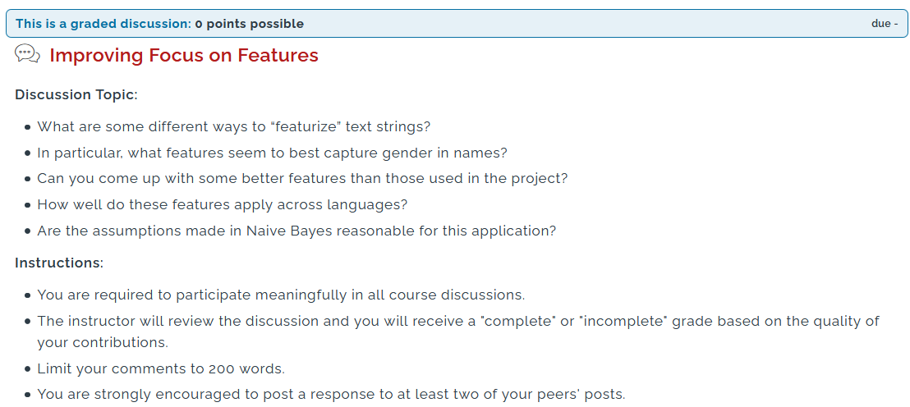

Slide 52
Questions?

Slide 53
Thank You For Attending!
End of Live Session 2

